Slide 1

SMART TECHNICIAN ASSIGNING
CREATED BY: SHANKAR KUMAR DHAR

Slide 2

TOPIC OUTLINE
1. Introduction
2. Objective
3. Advanced Features
4.Scope
5. Unique Features
6. Structure
7. System Requirement
8. Schema Diagram
9. Level 0 DFD
10. Level 1 DFD
11. Sequence Diagram
12. Use Case Diagram
13. UI Screenshot
14. Future Scope
15. Conclusion
16. Final Summary Of Project
17. Thank you

Slide 3

INTRODUCTION
The Technician Assignment Manager is a system designed to manage and assign technicians to different tasks efficiently. It helps track technician availability, assign jobs based on skills, and monitor work progress. Service delivery is enhanced, delays are minimized, and customer satisfaction is enhanced by this system.

Slide 4

OBJECTIVE
The objective of building a technician assignment manager website using the MERN stack (MongoDB, Express.js, Node.js) is to create a dynamic, user-friendly web application that allows users to interact book technicians , key goals include:
Efficient technician task assignment
Real-time availability tracking
Reduce service delays
Improve customer satisfaction
Streamline workflow
Optimize resource usage

Slide 5
ADVANCED FEATURES
1. Real-Time Technician Tracking
Key Point: Use location tracking (via GPS or manual updates).
Description: Allows the admin to see where technicians are currently located. Helps in assigning the nearest technician to a task to save time.
2. Automated Assignment Based on Skills & Availability
Key Point: Match technician skills with task requirements.
Description: The system auto-selects the best technician for a job based on their skill set and whether they are free. Reduces manual work.
3. Technician Performance Monitoring
Key Point: Track task completion time, ratings, and delays.
Description: Helps evaluate technician performance over time. Can be used for reports or rewards.
4.Secure Login & Session Management
Key Point: Simple authentication using username & password.
Description: Keeps the data secure and ensures only authorized users can access specific information.

Slide 6

SCOPE
Technician Registration and Login
Technicians can sign up and log in to the system.
Admin Login
Admin can log in to assign tasks and manage the system.
Task Assignment
Admin can assign tasks to technicians with details like task name, date, and customer.
View Assigned Tasks
Technicians can see the list of tasks assigned to them.
Simple Dashboard
Admin and technicians each have a dashboard to view relevant data.

Slide 7
UNIQUE FEATURES
1. ✅ Role-Based Access Control
Description: Separate login access for Admin and Technicians.
Benefit: Ensures data privacy and task-based views for each user role.
2. 🧰 Manual & Skill-Based Task Assignment
Description: Admin can assign tasks manually based on technician skills or availability.
Benefit: More accurate and efficient task distribution.
3. 📋 Real-Time Task Status Updates
Description: Technicians can update job status as “Pending”, “In Progress”, or “Completed”.
Benefit: Keeps admin informed about ongoing work in real time.
4. 📅 Technician Availability Status
Description: Technicians can mark themselves as “Available” or “Not Available”.
Benefit: Helps admin avoid assigning jobs to unavailable technicians.
5. 📊 Task History Tracking
Description: View list of past tasks completed by each technician.
Benefit: Useful for performance analysis and accountability.
6. 🔍 Smart Task Filtering
Description: Admin can filter tasks by date, technician, or status.
Benefit: Makes task management fast and organized.
7. 🛠️ Simple Dashboard for Admin and Technician
Description: Clear summary of assigned tasks, completed jobs, and technician details.
Benefit: Easy to use and understand for all users.
8. A Secure Method of Login Description: Password-protected login for all users.
Benefit: Prevents unauthorized access.
9. 📁 Minimal & Lightweight Design
Description: Designed to be fast and simple for small or medium businesses.
Benefit: Works well even without high-end systems or internet speed.

Slide 8








STRUCTURE
ADMIN PANEL
VIEW BOOKING ORDERS
VIEW SPARE PARTS ORDER AND AMOUNT
USERS
LOGIN
VIEW AND BOOK TECHNICIAN
ORDER SPARE PARTS

Slide 9

SYSTEM REQUIREMENT
HARDWARE REQUIREMENT:
PROCESSOR :- Dual core and above
RAM / ROM :- 10 Gb of free disk space & minimum 8Gb of RAM
MOTHERBOARD :- INTEL SOFTWARE REQUIREMENT:
OPERATING SYSTEM :- Windows 10, 11
PROG.LANGUAGE :- HTML, CSS, JS, React
DATABASE :- MONGODB
IDE USED :- VS Code

Slide 10
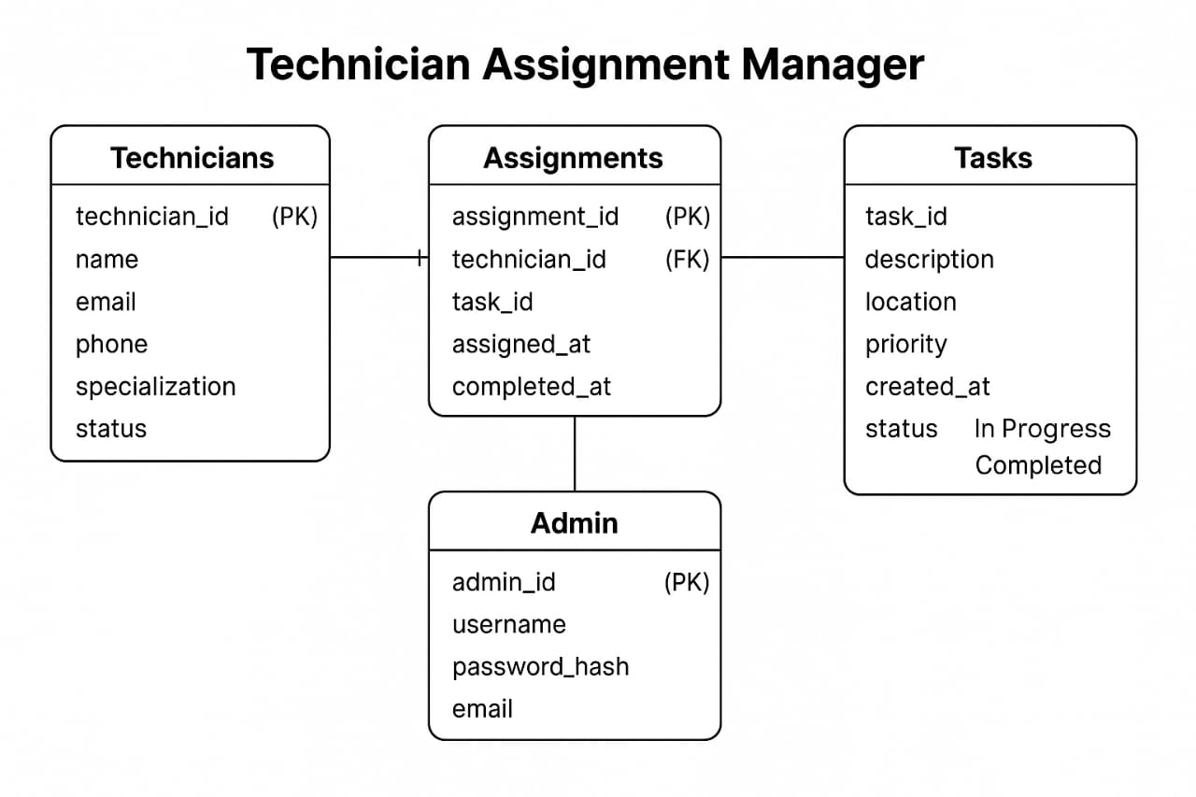
SCHEMA DIAGRAM

Slide 11
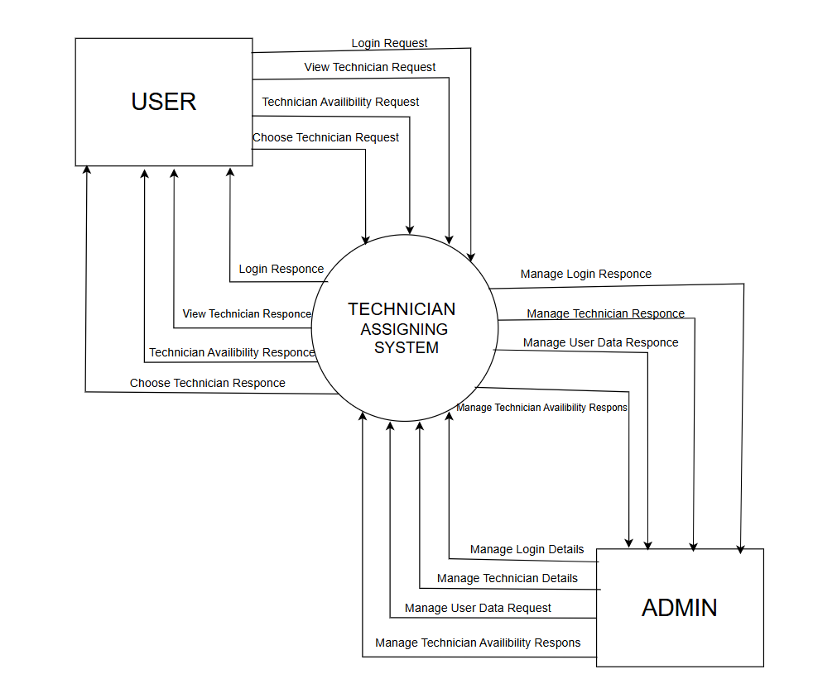

LEVEL 0 DFD STRUCTURE

Slide 12
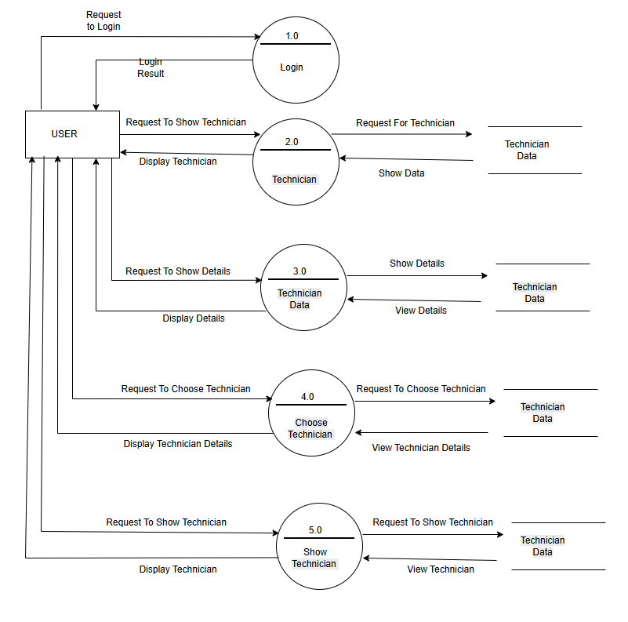
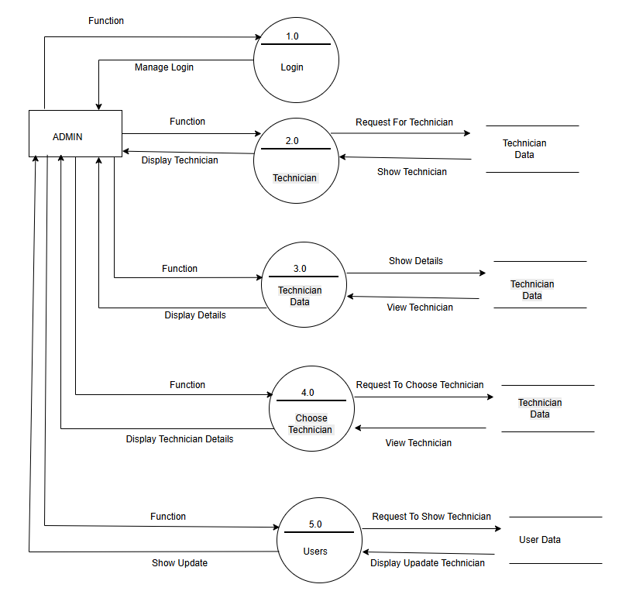
LEVEL 1 DFD STRUCTURE

Slide 13
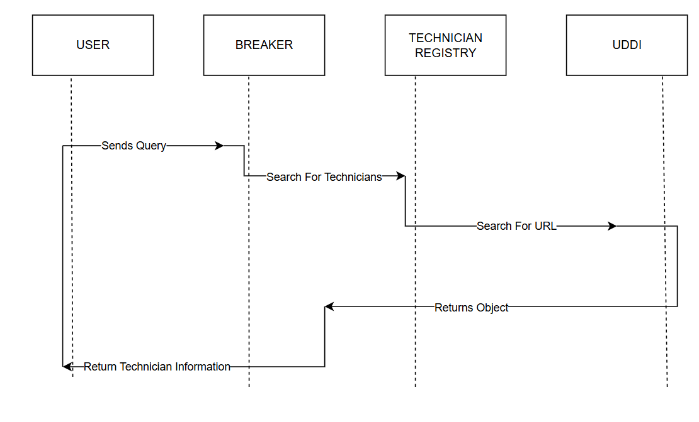

SEQUENCE DIAGRAM

Slide 14
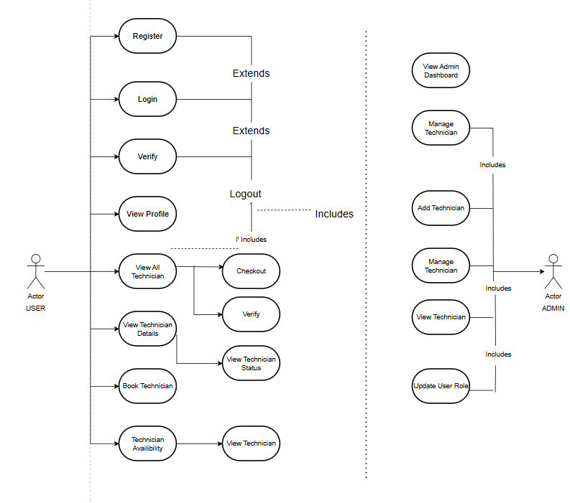

USE CASE DIAGRAM

Slide 15

PROJECT’S UI

Slide 16
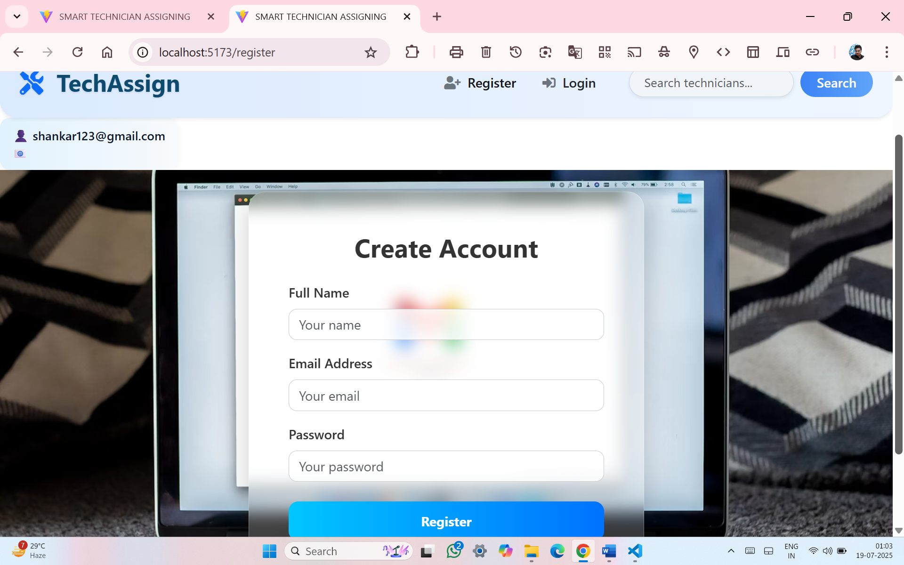
REGISTER PAGE

Slide 17
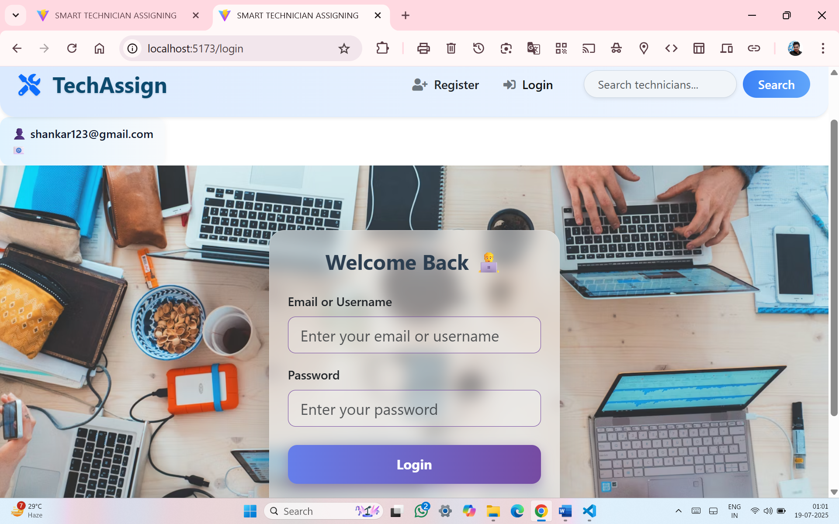
LOGIN PAGE

Slide 18
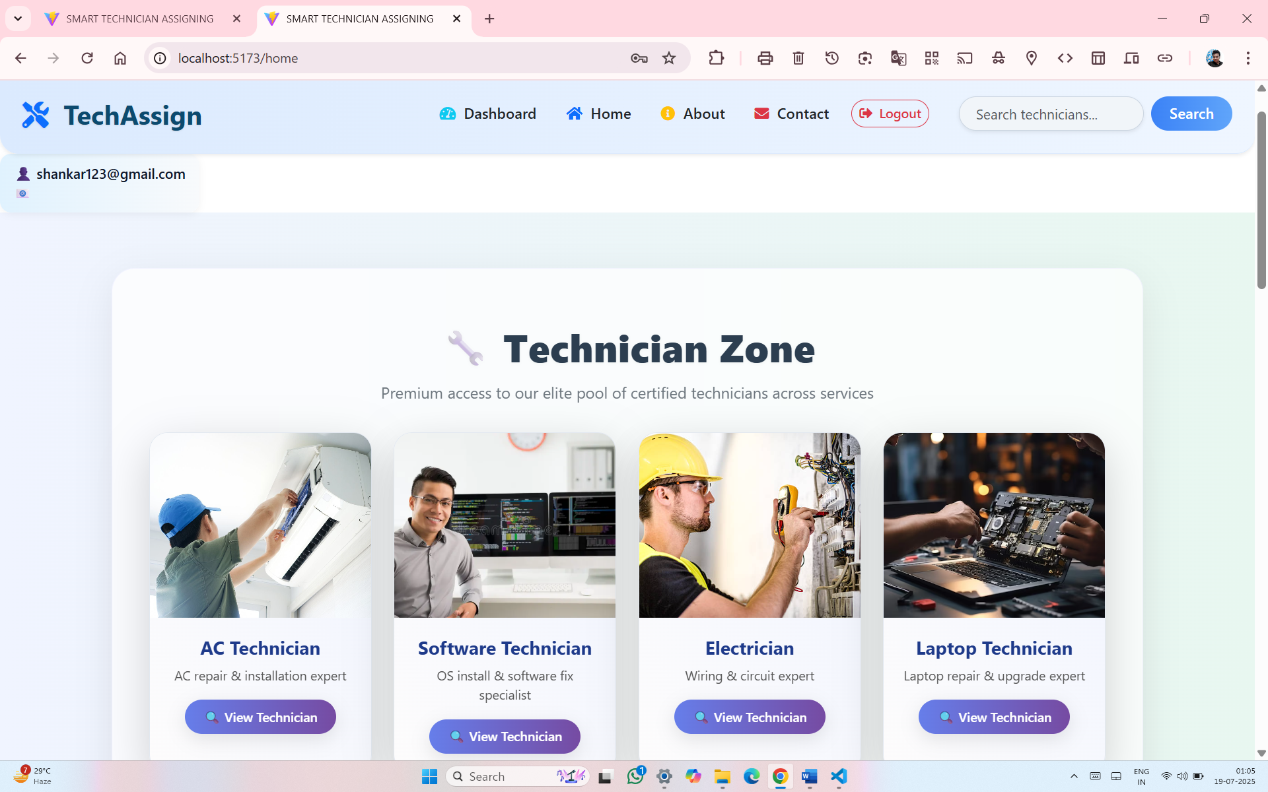
HOME PAGE

Slide 19
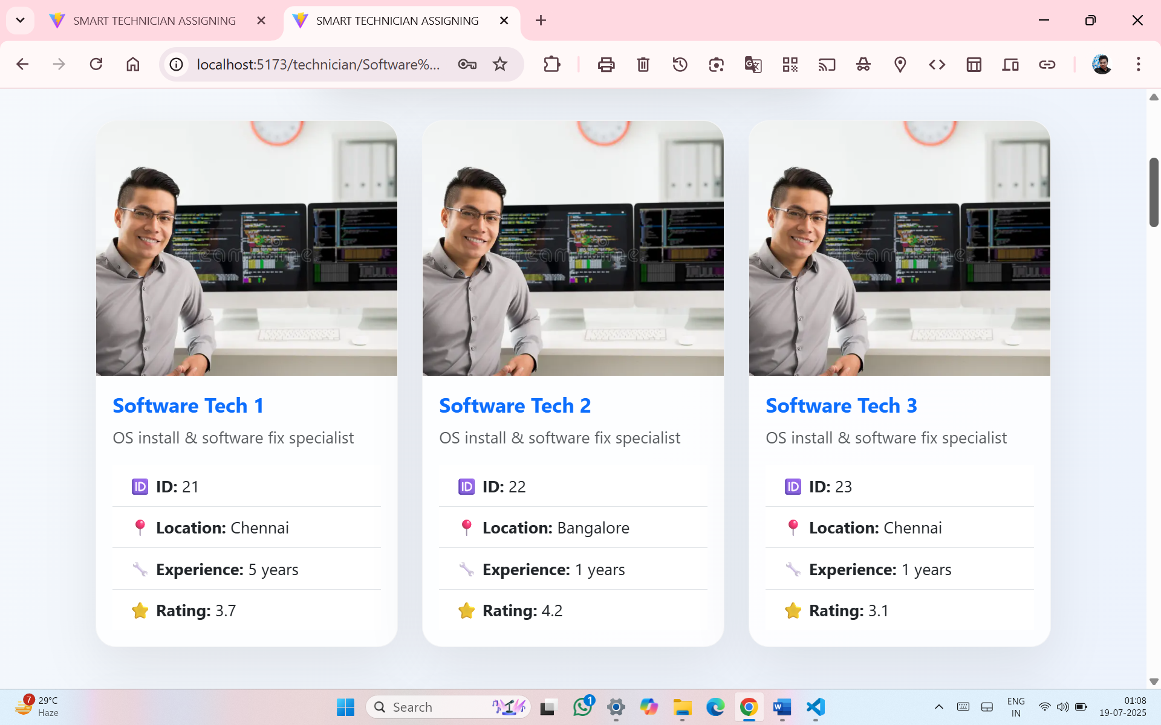
TECHNICIAN VIEW PAGE

Slide 20
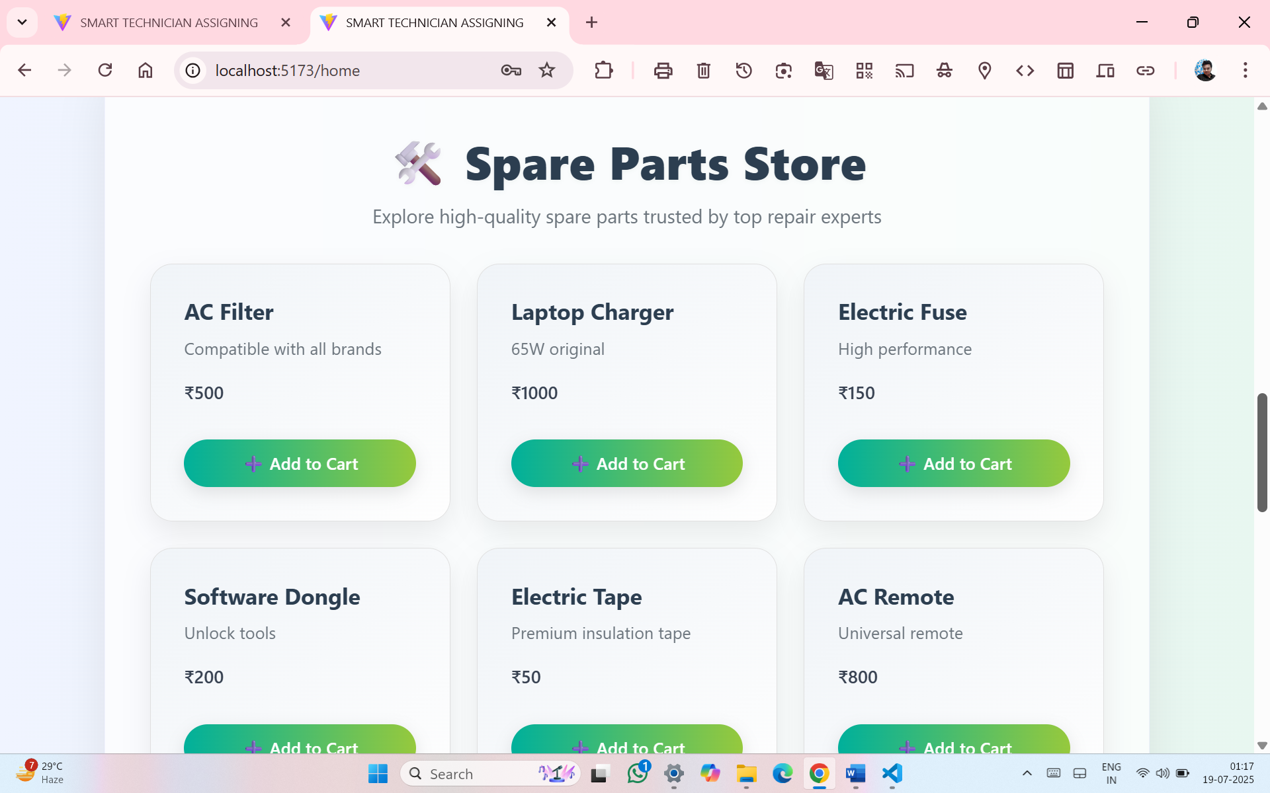
SPARE PARTS PAGE

Slide 21
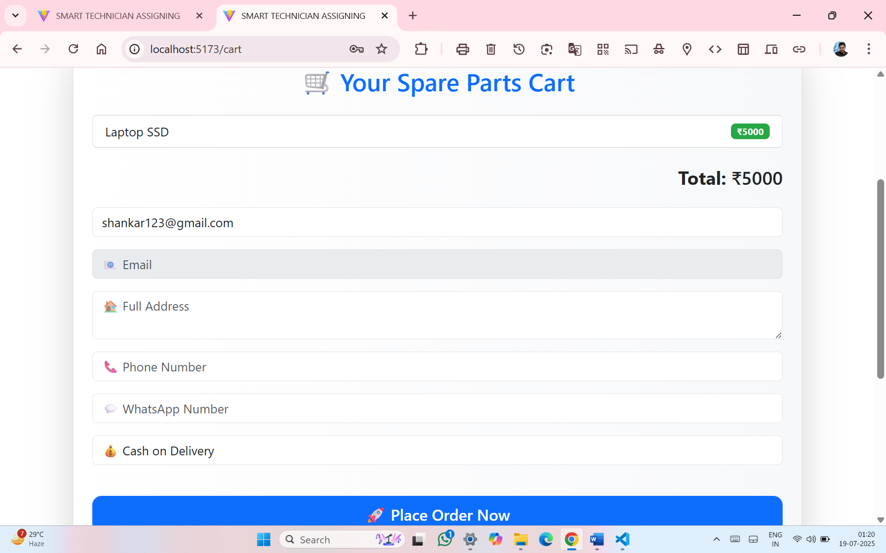
CART

Slide 22
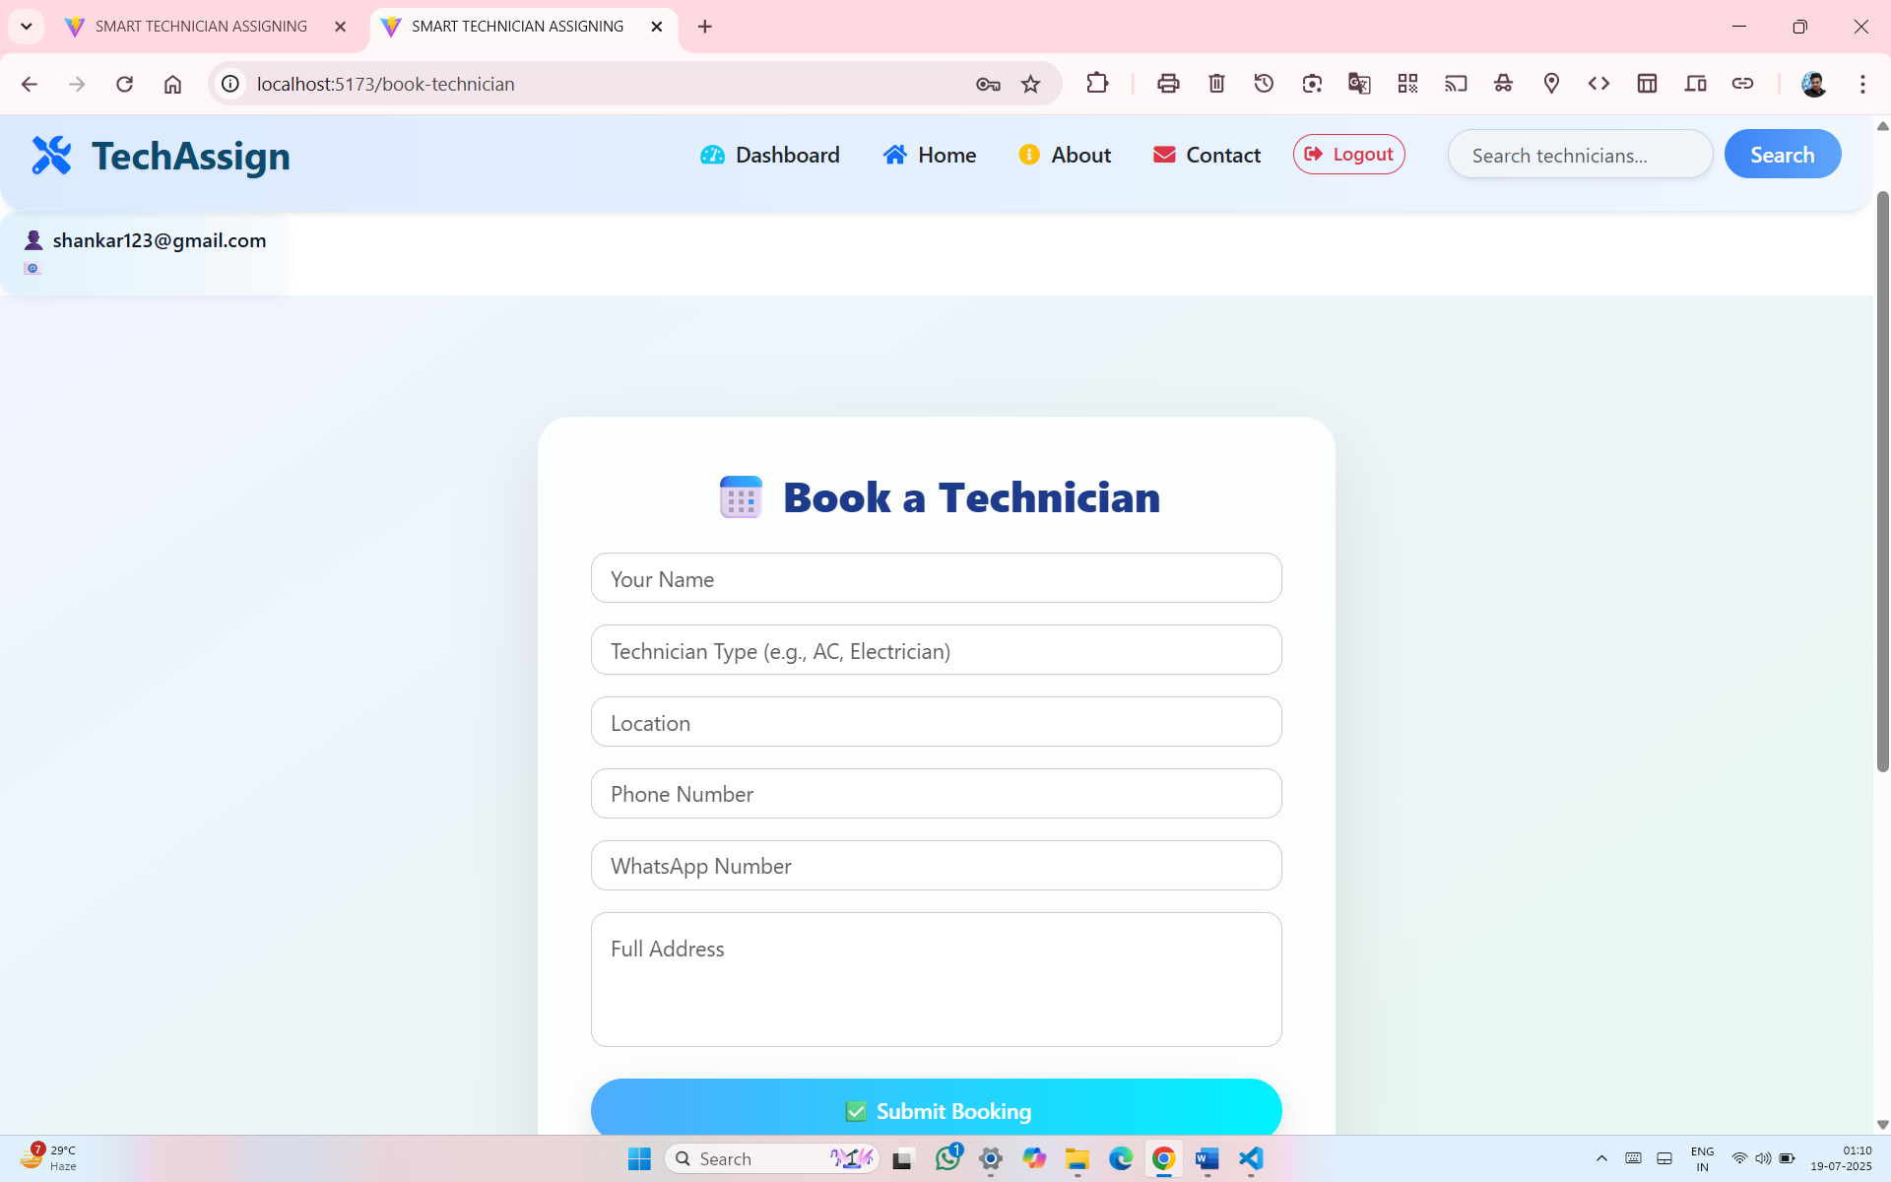
TECHNICIAN BOOKING PAGE

Slide 23
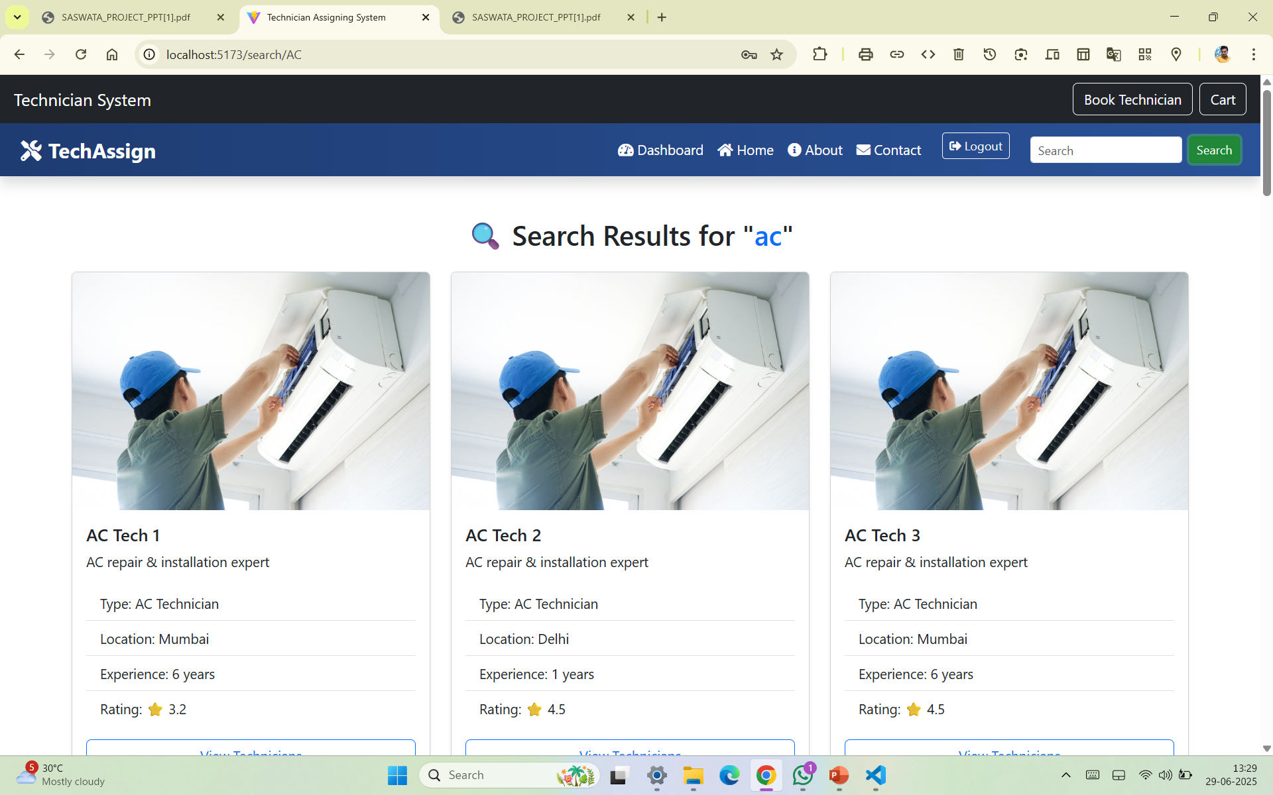
USER SEARCH

Slide 24
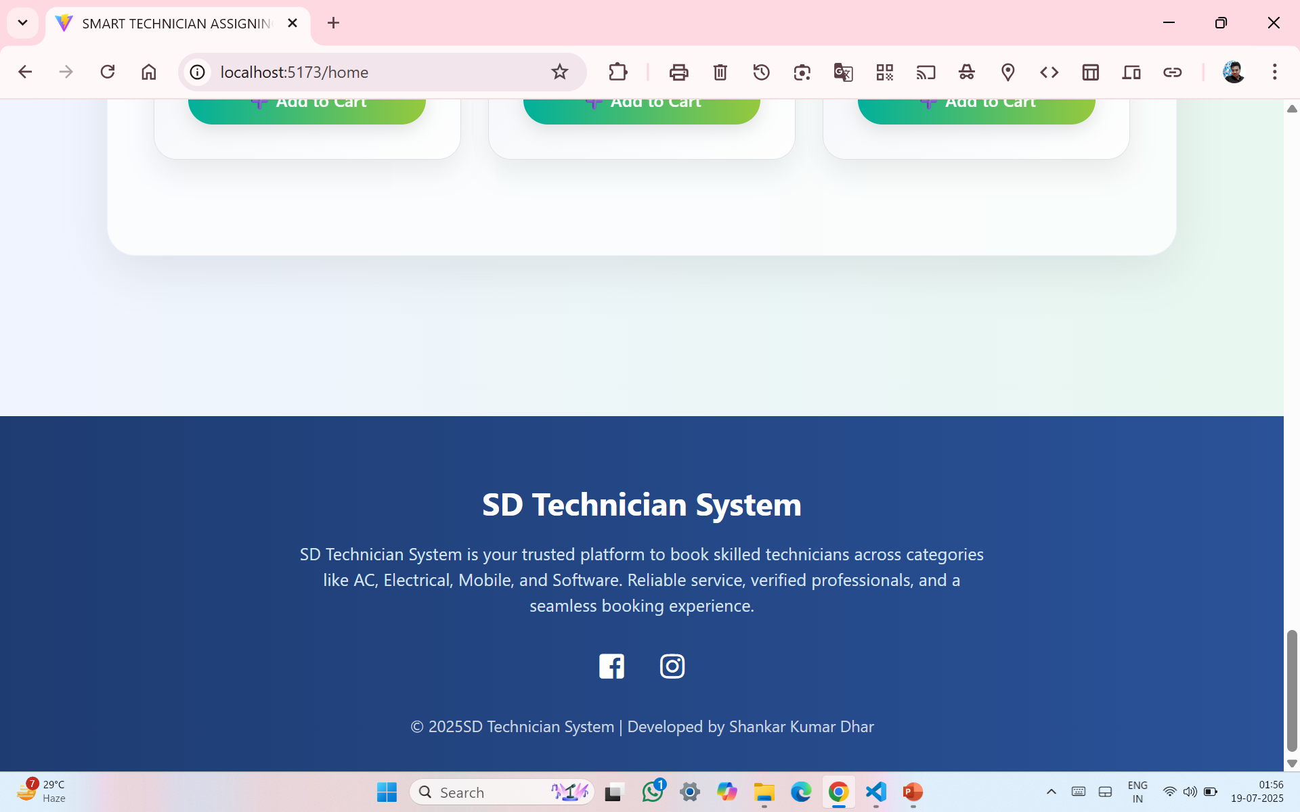
FOOTER

Slide 25
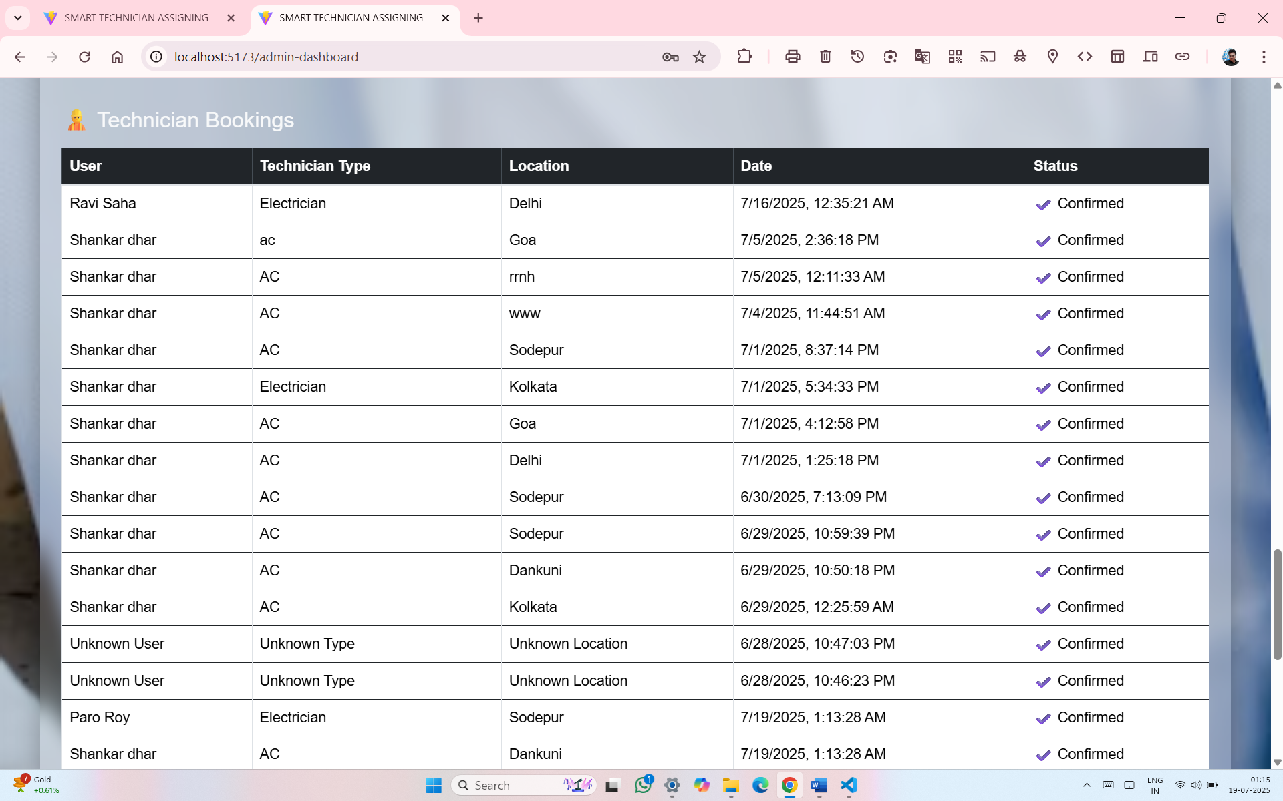
ADMIN DASHBOARD

Slide 26
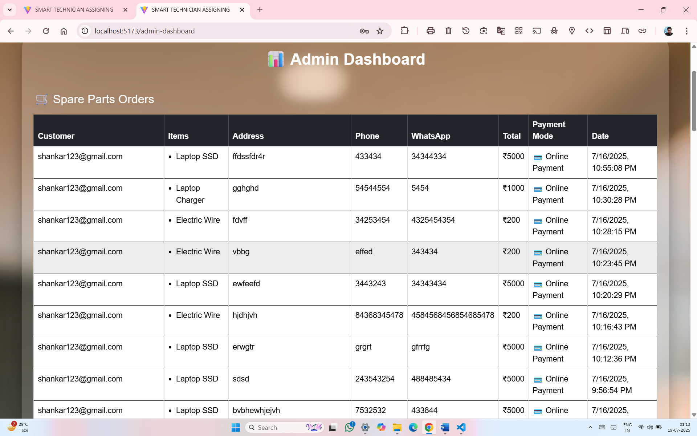
ADMIN SPARE PARTS ORDER

Slide 27
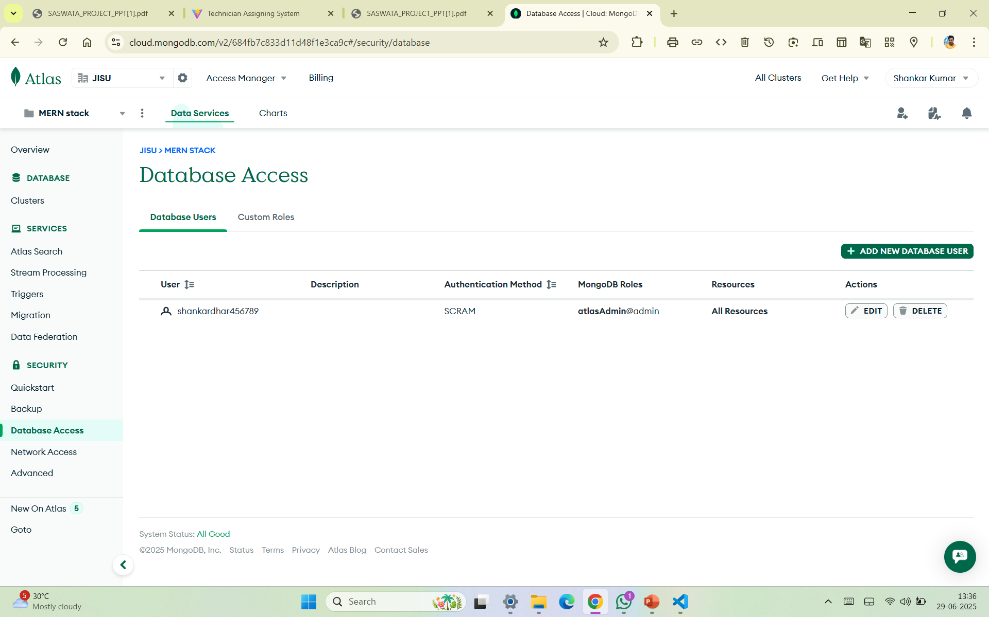
USER DATABASE

Slide 28
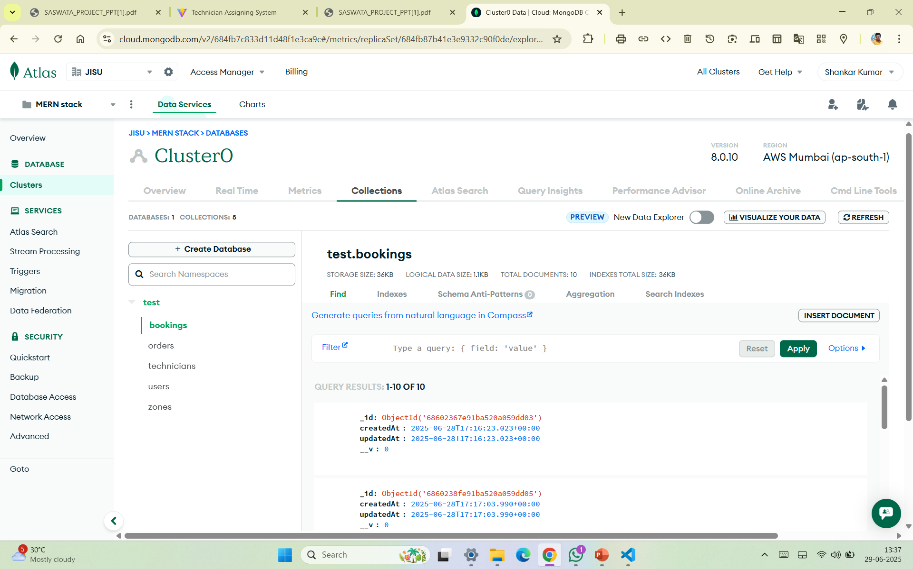
DATABASE

Slide 29
FUTURE SCOPE
The Technician Assignment Manager device has the ability for vast destiny improvement to make it smarter, faster, and greater person-friendly. Below are some possible future scope regions and upgrades:--
AI-Based Job Assignment: Use Artificial Intelligence to routinely assign jobs primarily based on technician performance history, vicinity, and skill suit.
Mobile Application Support:- Launch mobile apps for technicians and customers to update fame, track development, and provide remarks in real-time.
GPS & Route Optimization:- Integrate GPS monitoring to locate technicians and use path optimization for quicker carrier delivery.
Multi-Language Support:- Add local language options to make the system greater handy across distinctive geographies.
Integration with IoT Devices:- Use IoT sensors to car-generate service requests from smart home or business devices.

Slide 30
CONCLUSION
The Technician Assignment Manager device plays a crucial position in streamlining service operations with the aid of ensuring efficient technician allocation, actual-time monitoring, and well timed resolution of customer service requests. By automating job task based on technician abilities, place, and availability, the machine reduces guide errors, delays, and mismatches. It additionally enables obvious communication among clients, technicians, and directors.
Key benefits of the machine encompass:
Improved carrier shipping and customer pleasure
Real-time status monitoring of tasks
Optimal usage of technician assets
Reduced response time and better accountability

Slide 31
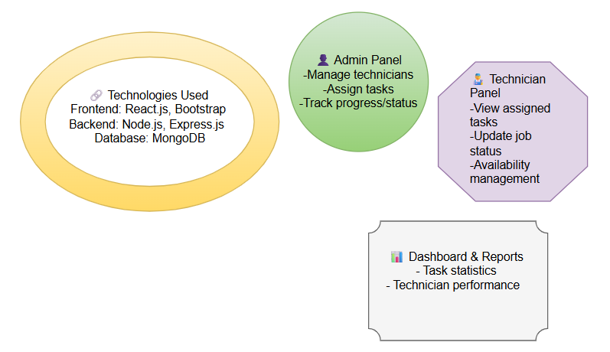
THE FINAL SUMMARY OF THE PROJECT

Slide 32

THANK YOU

